Slide 1
Mapping Structure, Functions, and Components of DBMS
Detailed Presentation with Examples and Notes

Slide 2
Introduction to DBMS
A Database Management System (DBMS) is software that facilitates structured data storage, management, and retrieval. It provides an abstraction over data storage and ensures efficient access.

Slide 3
DBMS Mapping Structure
DBMS follows a three-level architecture:
1. Internal Level (Physical Storage)
2. Conceptual Level (Logical Structure)
3. External Level (User Views)
Mappings ensure smooth transition between these levels.

Slide 4
Internal Level (Physical Storage)
• Deals with how data is stored on disks or SSDs.
• Uses indexing, hashing, and file organization techniques.
Example: Storing employee records as B-trees for faster retrieval.

Slide 5
Conceptual Level (Logical Schema)
• Defines tables, relationships, keys, and constraints.
• Independent of physical storage details.
Example: A relational model defining Employee(EmployeeID, Name, Salary).

Slide 6
External Level (User Views)
• Provides different views for different users.
• Ensures security and abstraction.
Example: A professor sees only student grades, while an admin sees full student details.

Slide 7
Functions of DBMS
1. Data Definition (DDL)
2. Data Storage & Retrieval
3. Data Manipulation (DML)
4. Transaction Management
5. Security & Authorization
6. Backup & Recovery
7. Data Integrity & Consistency

Slide 8
Data Definition (DDL)
Defines database schema using commands like:
• CREATE TABLE, ALTER TABLE, DROP TABLE
Example:
CREATE TABLE Students (ID INT PRIMARY KEY, Name VARCHAR(50));

Slide 9
Data Manipulation (DML)
Performs CRUD operations using:
• INSERT, UPDATE, DELETE, SELECT
Example:
INSERT INTO Students VALUES (1, 'Alice');

Slide 10
Transaction Management (ACID)
Ensures ACID properties:
• Atomicity: Complete or rollback transaction
• Consistency: Data remains valid
• Isolation: Transactions don’t interfere
• Durability: Changes persist after commit

Slide 11
Security & Authorization
Controls access using GRANT and REVOKE.
Example:
GRANT SELECT ON Students TO Professor;
REVOKE DELETE ON Students FROM Professor;

Slide 12
Components of DBMS
1. Database Engine
2. Storage Manager
3. Query Processor
4. Transaction Manager
5. Metadata Catalog
6. User Interface & APIs
7. Concurrency Control Manager

Slide 13
Database Engine
• Core component that processes queries and transactions.
• Converts SQL queries into low-level operations.
Example: MySQL, PostgreSQL, Oracle Database engines.
A database engine is a component of software that facilitates working with databases. It controls how information in a database is saved, retrieved, and altered. Database engines act as a bridge between the database's data and the user, facilitating interaction with the information stored there. MySQL, Oracle, and SQL Server are just a few of the most well-known database management systems.

Slide 14
How Relational Database Engines Work
Relational database engines store data in tables, with each table representing a different entity or object. Each table has a unique primary key that is used to identify the rows in the table. Tables can be related to each other using foreign keys, which are used to establish relationships between tables.
To retrieve data from a relational database, users use SQL queries. SQL is a standard language used to manipulate relational databases. SQL queries are used to select, insert, update, and delete data from the database.

Slide 15
How NoSQL Database Engines Work
NoSQL databases are designed to handle unstructured or semi-structured data, which makes them highly flexible and scalable. NoSQL databases use a variety of data models to store data, including document, key-value, graph, and column-family models.
In a document model, data is stored in a document, which is similar to a JSON object. In a key-value model, data is stored as a set of key-value pairs. In a graph model, data is stored as nodes and edges, which are used to represent relationships between objects. In a column-family model, data is stored in columns, which are grouped into column families.

Slide 16
In-Memory Database Engines
In-memory database engines are made to keep data in memory instead of on a hard drive. This makes them very useful because info can be found and changed quickly. In-memory databases are frequently used in programmes that need to handle data in real-time, like online trading platforms and games.
How In-Memory Database Engines Work
In-memory database engines keep information in memory, which makes them very fast. Standard SQL queries are used to get and change data, just like in regular relational databases. In-memory databases are often used with traditional databases, where data is first saved on a hard drive and then cached in memory so it can be accessed quickly.
Examples of In-Memory Database Engines
SAP HANA:
SAP HANA is an in-memory database engine that is widely used in enterprise applications. It is known for its high performance and scalability.
Redis:
Redis is an open-source in-memory database engine that is commonly used as a cache. It provides a range of features for storing and retrieving data in memory.

Slide 17
Complete Explanation:
SQL database engines are designed to manage data in a structured manner using tables, rows, and columns. The core components of a SQL database engine include the Query Parser, Query Optimizer, Query Executor, and Storage Engine.
Query Parser
The Query Parser is the first point of contact with the database engine. When you execute a SQL query, the parser validates the syntax, checks for grammatical errors, and creates an internal representation of the query known as a parse tree. The parse tree helps break down the question into its components for further processing.
Query Optimizer
The Query Optimizer analyses the parse tree and determines the most efficient way to execute the query. It evaluates various query execution plans, estimates costs, and selects the lowest price. This step ensures that the database engine fetches and processes data optimally, improving query performance.

Slide 18
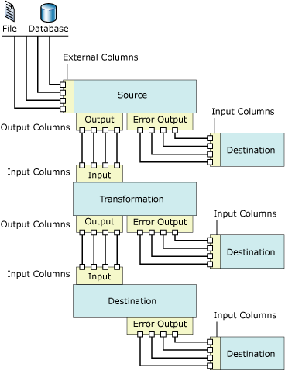

Slide 19
The transaction manager
(TxM) is a special resource manager that implements the resource type “transaction.” It handles all the state transitions that a transaction can perform. For simple ACID transactions these are: begin, savepoint, rollback, abort, prepare commit; for more refined transaction models there will be additional states. The resource managers register with the TxM when they get employed by a transaction for the first time. Thus, the TxM keeps a record for each transaction of which resource managers have been involved with it. In the same vein, it stores which sessions each transaction has used in case it has performed operations on other nodes in a distributed system. The TxM closely interacts with the concurrency control manager who can make transaction wait for other transactions in case of access conflicts. It also interacts with the logging and recovery subsystem and the communications manager.

Slide 20
CCM
The concurrency control manager (CCM) synchronizes the concurrent access of database transactions to shared objects in the database. It is responsible for maintaining the guarantees regarding the effects of concurrent access to the shared database, i.e., it will protect each transaction from anomalies that can result from the fact that other transactions are accessing the same data at the same time. Ideally, it will make sure that the result of transactions running in parallel is identical to the result of some serial execution of the same transactions. In real applications, however, some transactions may opt for lower levels of synchronization, thus trading protection from side effects of other transactions for performance. The CCM is responsible for orchestrating all access requests issued by the transactions such that each transaction receives the level of protection it has asked for.

Slide 21
How does a CCM work?
The CCM synchronizes access requests from transactions
It implements synchronization protocols to ensure that transactions execute correctly
It protects transactions from anomalies that can occur when multiple transactions access the same data
It ensures that the result of parallel transactions is the same as if they were executed in a serial fashion
Why is concurrency control important?
It helps maintain data consistency and integrity
It improves system efficiency and throughput
It protects transaction atomicity
It prevents dirty reads, where one transaction reads data that another transaction is updating
It avoids cascading rollbacks, which occur when one transaction fails and causes others to fail

Slide 22
Storage Engine
The Storage Engine manages how data is stored on disk and accessed. It handles tasks such as data retrieval, insertion, and deletion efficiently. Various data structures, such as B-trees, organise the data, allowing fast access and modification.
Query Executor
Once the optimal query execution plan is chosen, the Query Executor executes the program and retrieves the requested data. It interacts with the Storage Engine to fetch the data from the physical storage and returns the result to the user.

Slide 23
Using the Metadata APIs
The DBMS_METADATA APIs enable you to check and update object metadata.
The DBMS_METADATA API enables you to do the following:
Retrieve an object's metadata as XML
Transform the XML in a variety of ways, including transforming it into SQL DDL
Submit the XML to re-create the object extracted by the retrieval
The DBMS_METADATA_DIFF API lets you compare objects between databases to identify metadata changes over time in objects of the same type.
Why Use the DBMS_METADATA API?
The DBMS_METADATA API eliminates the need for you to write and maintain your own code for metadata extraction.
Overview of the DBMS_METADATA API
Learn how to take advantage of the DBMS_METADATA API features.
Using the DBMS_METADATA API to Retrieve an Object's Metadata
The retrieval interface of the DBMS_METADATA API lets you specify the kind of object to be retrieved.
Using the DBMS_METADATA API to Recreate a Retrieved Object
When you fetch metadata for an object, you can choose to use it to recreate the object in a different database or schema.
Using the DBMS_METADATA API to Retrieve Collections of Different Object Types
To retrieve collections of objects in which the objects are of different types, but comprise a logical unit, you can use the heterogeneous object types in the DBMS_METADATA API.

Slide 24
The DBMS_METADATA API eliminates the need for you to write and maintain your own code for metadata extraction.
If you have developed your own code for Oracle Database for extracting metadata from the dictionary, or for manipulating the metadata (adding columns, changing column data types, and so on), and converting the metadata to DDL so that you could recreate the object on the same or another database, then maintenance is an issue. Keeping that code updated to support new dictionary features has probably proven to be challenging.
Oracle Database provides a centralized facility for the extraction, manipulation, and recreation of dictionary metadata. Oracle Database also supports all dictionary objects at their most current level.

Slide 25
Storage Manager
• Manages data storage on disks and memory.
• Uses indexing, partitioning, and file organization techniques.
Example: A B-tree index helps speed up search operations.

Slide 26
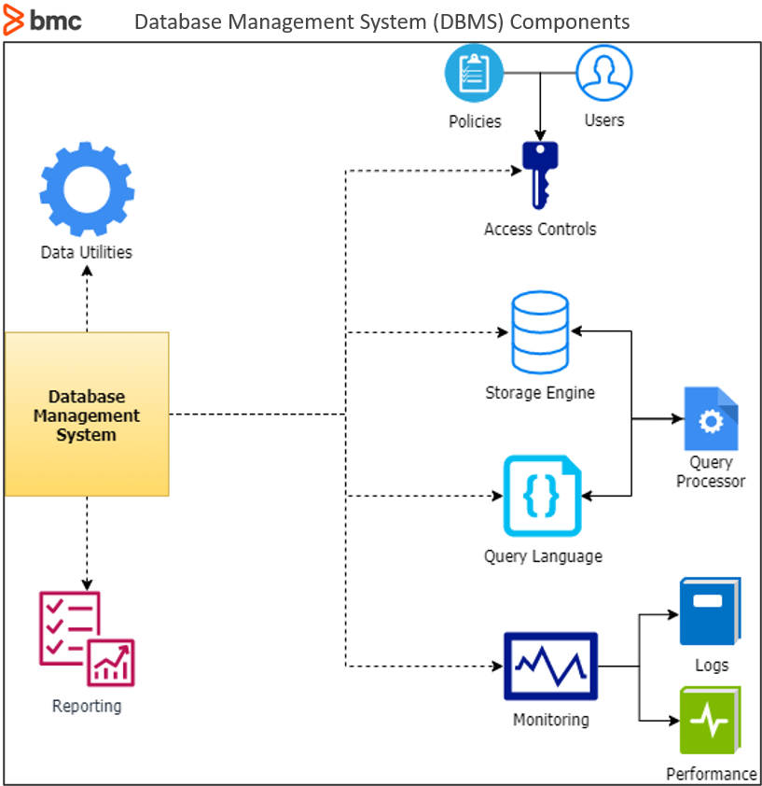

Slide 27
Storage engine in a database
The database storage engine is the core component of the DBMS that interacts with the file system at an OS level to store data. All SQL queries which interact with the underlying data go through the storage engine.
Which storage engine is the best for a database?
The right storage engine depends on your data model. SQL engines supporting transactions work well with relational databases. Non-relational models, especially those that require scalability, work best with MongoDB or Cassandra.

Slide 28
Query processor
The query processor is the intermediary between user queries and the database. In DBMS, query processing is the process of interpreting user queries, such as SQL, and making them actionable commands that the database can understand to perform the appropriate functionality.
What are the components of the query processor?
The query processor components each work together to extract data.
Parser. This component translates a user query into a database language such as SQL, parses it for correct syntax, and verifies its logical meaning.
Optimizer. This component converts the query into logical relational operations, identifies how much time and energy it will take to execute the query, and then specifies the exact operations and sequence for the most efficient execution.

Slide 29
Execution engine. This is the component that carries out the query, implements algorithms and operators according to the optimized plan, and finally retrieves and formats the results.
Query cache. Some systems include a component that stores frequently executed queries and results to save time and improve performance.

Slide 30
Query Processor
• Interprets and optimizes SQL queries.
• Generates an execution plan for efficient data retrieval.
Example: SELECT * FROM Students WHERE Age > 20;

Slide 31
Transaction Manager
• Ensures ACID compliance.
• Manages concurrency and rollback mechanisms.
Example: Handling simultaneous bookings in a train reservation system.

Slide 32
Metadata Catalog
• Stores schema definitions, constraints, and indexing information.
Example:
SELECT * FROM INFORMATION_SCHEMA.TABLES;

Slide 33
Concurrency Control Manager
• Ensures multiple users can access the database without conflicts.
• Uses Locking and Multiversion Concurrency Control (MVCC).
Example: Handling multiple bank transactions without data loss.

Slide 34
Conclusion
DBMS provides structured data storage, efficient retrieval, and robust security using a well-defined mapping structure and core components.

